Slide 1
FACE DETECTION
using custom weights and self trained models

Slide 2
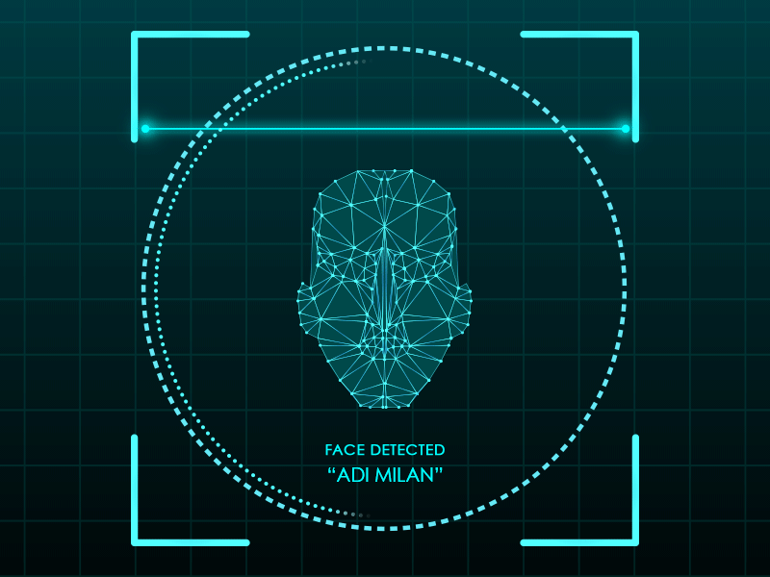
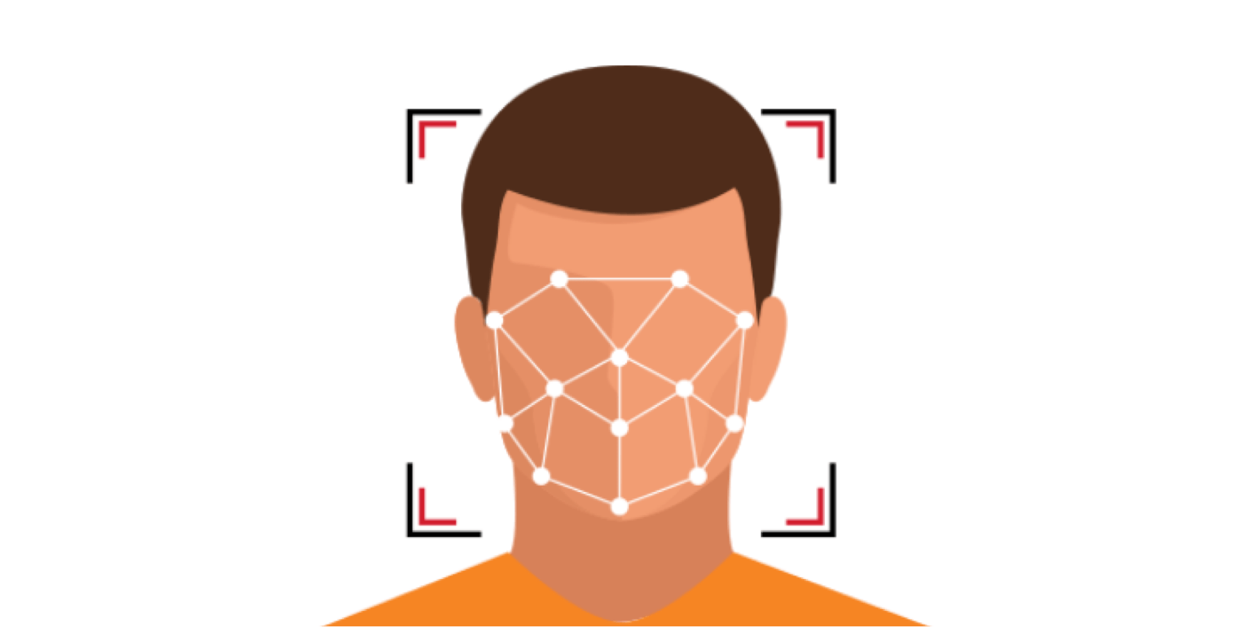
REQUIREMENTS:
PIP
Python
OpenCV
Anaconda
Colab
GIT
Sublime text
Notepad++

Slide 3
Face Recognition:
Face Detection:
Also called Facial Detection - is an AI based computer technology used to find and identify human faces in digtal images.
it is a category of biometric software that maps an individuals facial features mathematically and stores the data as a face print.

Slide 4
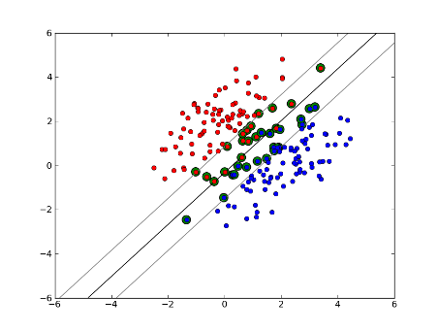
SUPPORT VECTOR MACHINE(SVM)

Slide 5
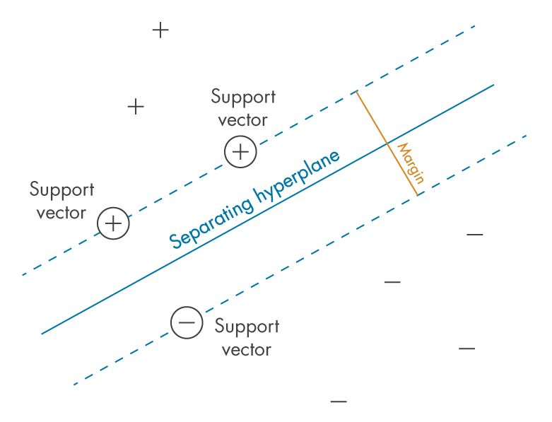
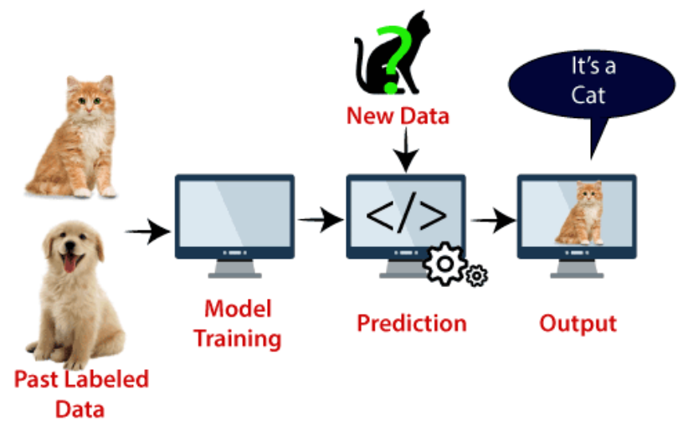
WHAT IS SVM :
Support Vector Machine or SVM is one of the most popular Supervised Learning algorithms.
The goal of the SVM algorithm is to create the best line or decision boundary that can segregate n-dimensional space into classes so that we can easily put the new data point in the correct category in the future. This best decision boundary is called a hyperplane.
SVM chooses the extreme points/vectors that help in creating the hyperplane. These extreme cases are called as support vectors, and hence algorithm is termed as Support Vector Machine.
EXAMPLE: Suppose we see a strange cat that also has some features of dogs, so if we want a model that can accurately identify whether it is a cat or dog, so such a model can be created by using the SVM algorithm. We will first train our model with lots of images of cats and dogs so that it can learn about different features of cats and dogs, and then we test it with this strange creature. So as support vector creates a decision boundary between these two data (cat and dog) and choose extreme cases (support vectors), it will see the extreme case of cat and dog. On the basis of the support vectors, it will classify it as a cat.

Slide 6
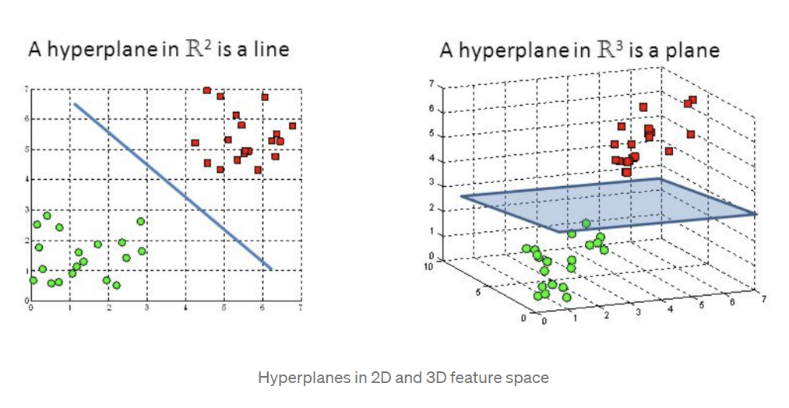
IMPORTANT TERMINOLOGIES :
HYPERPLANE (DECISION SURFACE) :
A hyperplane is a decision boundary that differentiates the two classes in SVM. A data point falling on either side of the hyperplane can be attributed to different classes.
The dimension of the hyperplane depends on the number of input features in the dataset. If we have 2 input features the hyper-plane will be a line. likewise, if the number of features is 3, it will become a two-dimensional plane.

Slide 7
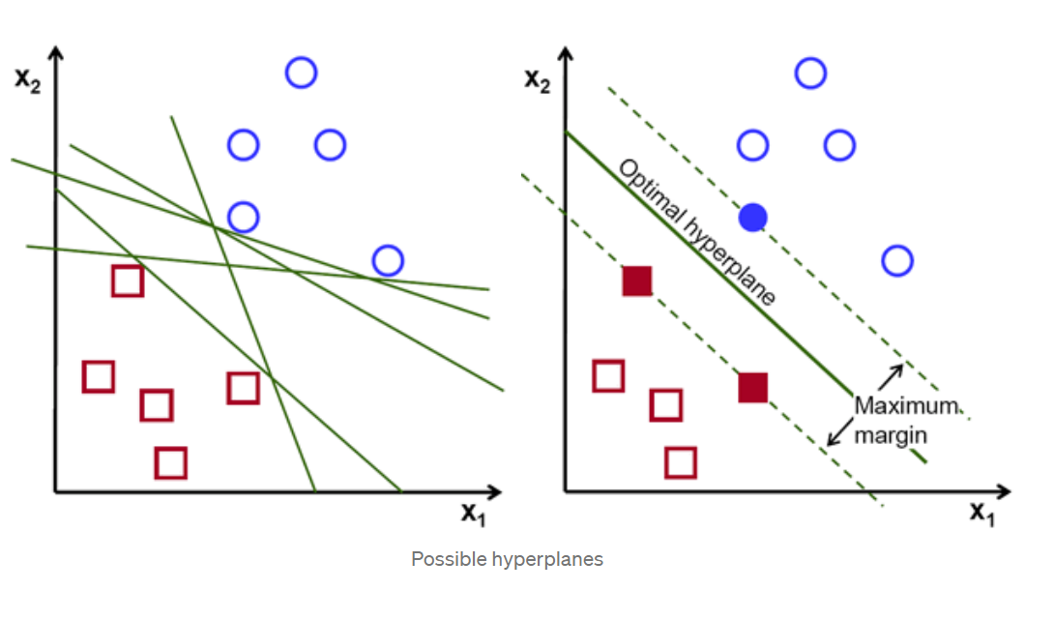
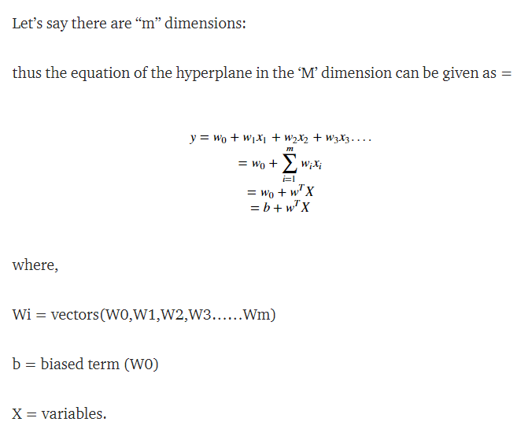
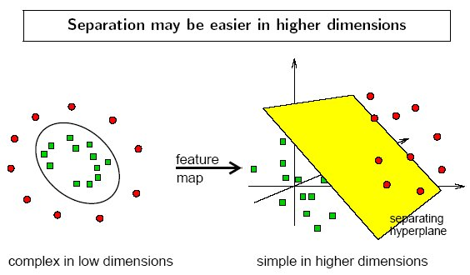
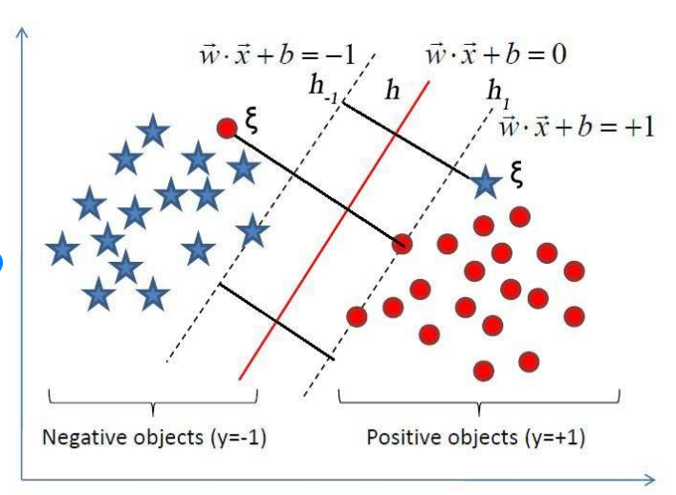
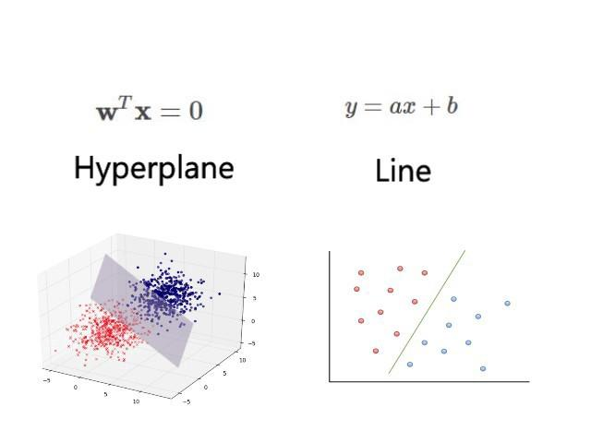

Slide 8
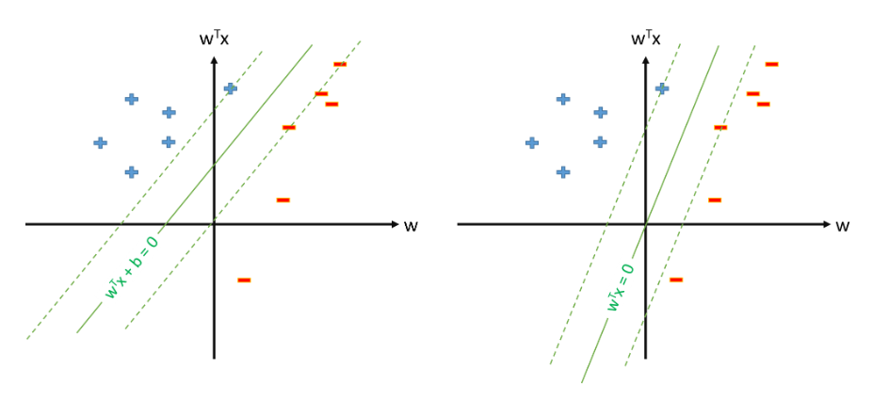
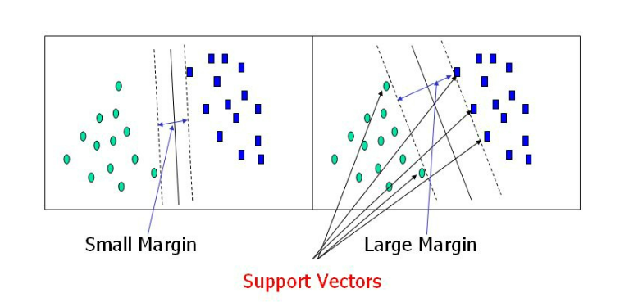
WHY BIAS IS IMPORTANT:
The bias term b is indeed a special parameter in SVM.
Without it, the classifier will always go through the origin.
So, SVM does not give you the separating hyperplane with the maximum margin if it does not happen to pass through the origin, unless you have a bias term.
SUPPORT VECTOR:
Support vectors are data points that are closer to the hyperplane and influence the position and orientation of the hyperplane. Using these support vectors, we maximize the margin of the classifier. Deleting the support vectors will change the position of the hyperplane. These are the points that help us build our SVM.
MARGIN:
It may be defined as the gap between two lines on the closet data points of different classes. It can be calculated as the perpendicular distance from the line to the support vectors. Large margin is considered as a good margin and small margin is considered as a bad margin.

Slide 9
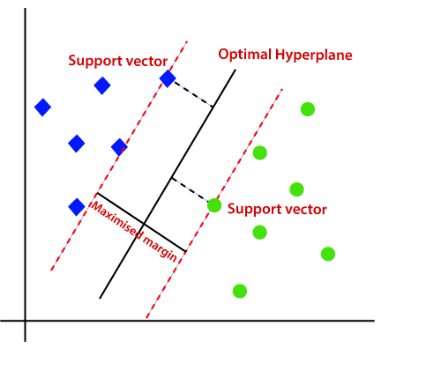
The main goal of SVM is to divide the datasets into classes to find a maximum marginal hyperplane (MMH) and it can be done in the following two steps −
First, SVM will generate hyperplanes iteratively that segregates the classes in best way.
Then, it will choose the hyperplane that separates the classes correctly.
MAXIMIZE THE MARGIN FORMULAE IN SVM:
The hyperplane that maximizes the margin reduces the generalization error the most.
Margin distance : 2/(norm W) where w = weights
Optimization Technique used in SVM
The core of any Machine learning algorithm is the Optimization technique that is happening behind the scene.
SVM maximizes the margin by learning a suitable decision boundary/decision surface/separating hyperplane.

Slide 10
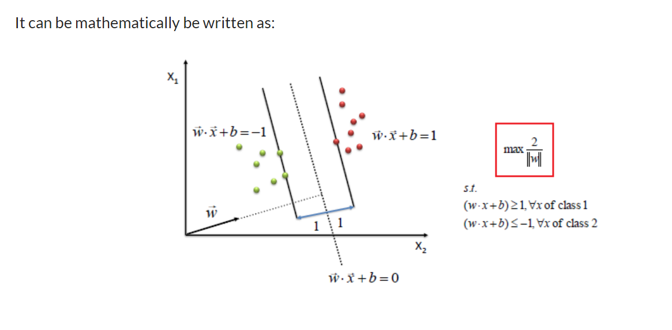
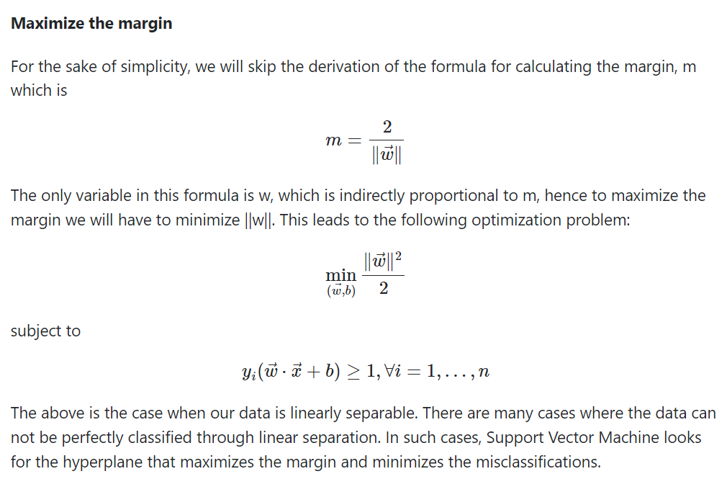

Slide 11
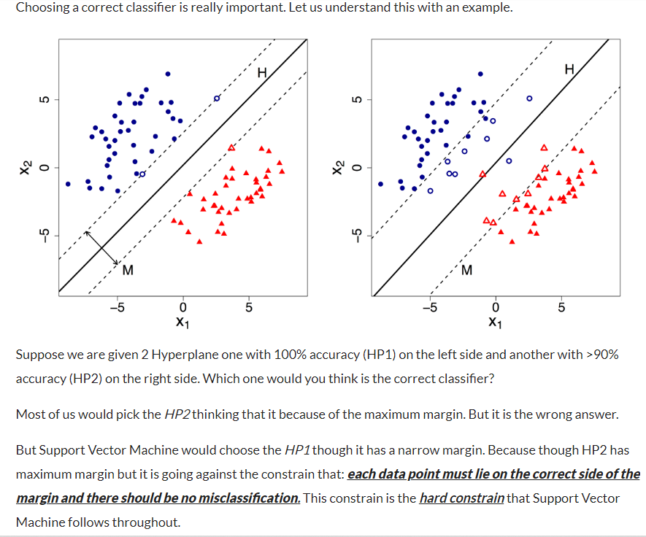
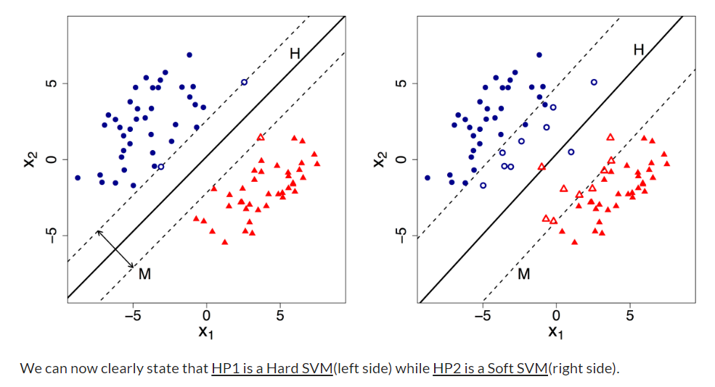
HARD AND SOFT SVM:
Hard margin SVM does not allow any misclassification to happen.
In case our data is non-separable/ nonlinear then the Hard margin SVM will not return any hyperplane as it will not be able to separate the data. Hence this is where Soft Margin SVM comes to the rescue.
Soft margin SVM allows some misclassification to happen by relaxing the hard constraints of Support Vector Machine.

Slide 12
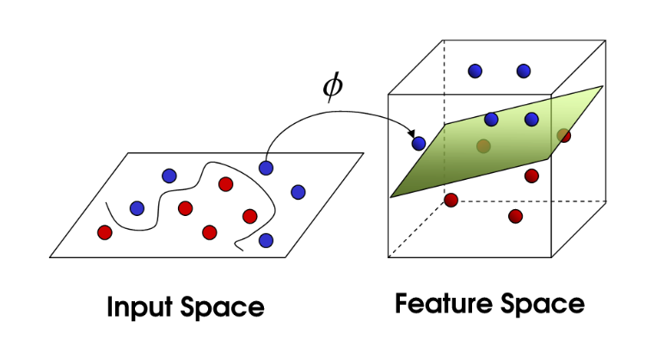
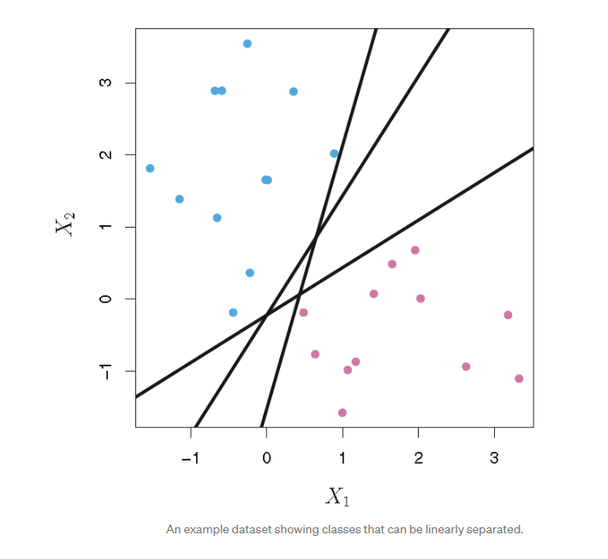
KERNEL TRICK
Support Vector Machine deals with nonlinear data by transforming it into a higher dimension where it is linearly separable.
Support Vector Machine does so by using different values of Kernel.
We have various options available with kernel like, ‘linear’, “rbf”, ”poly” and others (default value is “rbf”). Here “rbf” and “poly” are useful for non-linear hyper-plane.
In the following 2-d example, we can separate the data with any of the three lines, and then just assign classes based on whether the observation lies above or below the line. The data are 2-dimensional vectors specified by the features X1 and X2 with class labels as either y =1 (blue) or y = 0 (red).
To train a support vector classifier, we find the maximal margin hyperplane, or optimal separating hyperplane, which optimally separates the two classes in order to generalize to new data and make accurate classification predictions.

Slide 13
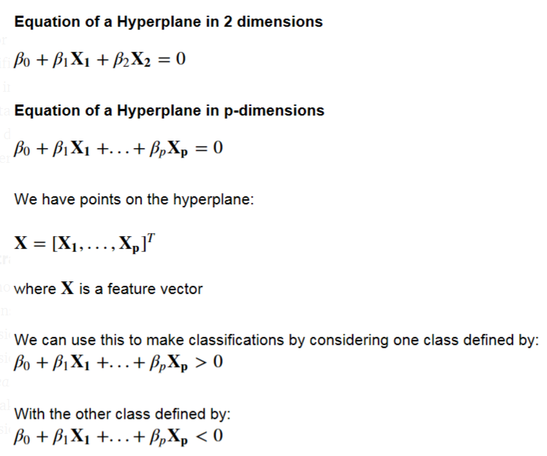
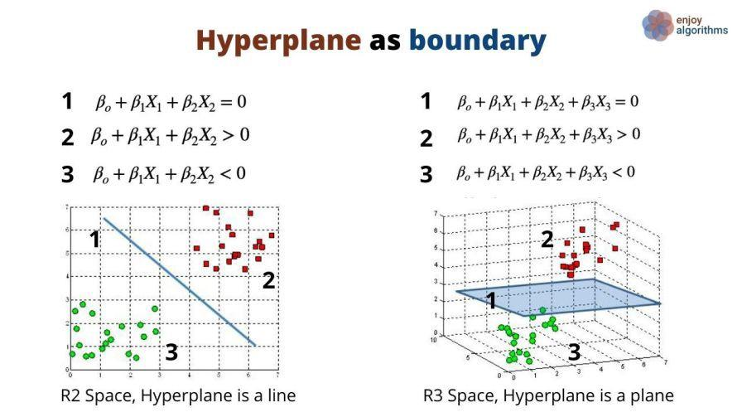
Support vector machines are much harder to interpret in higher dimensions. It is much harder to visualize how the data can be linearly separable, and what the decision boundary will look like. A hyperplane in p-dimensions is a p-1 dimensional “flat” subspace that lies inside the larger p-dimensional space.
In 2 dimensions, the hyperplane is just a line. In 3 dimensions, the hyperplane is a regular 2-d plane.
Support vector classification relies on this notion of linearly separable data. “Soft margin” classification can accommodate some classification errors on the training data, in the case where data is not perfectly linearly separable. However, in practice data is often very far from being linearly separable, and we need to transform the data into a higher dimensional space in order to fit a support vector classifier.
Mathematically, we have the following:

Slide 14
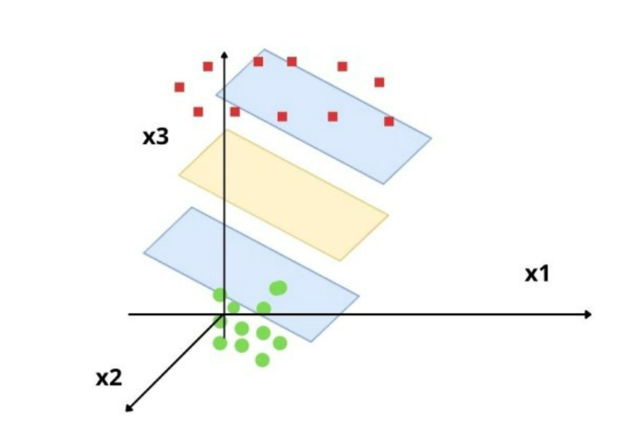
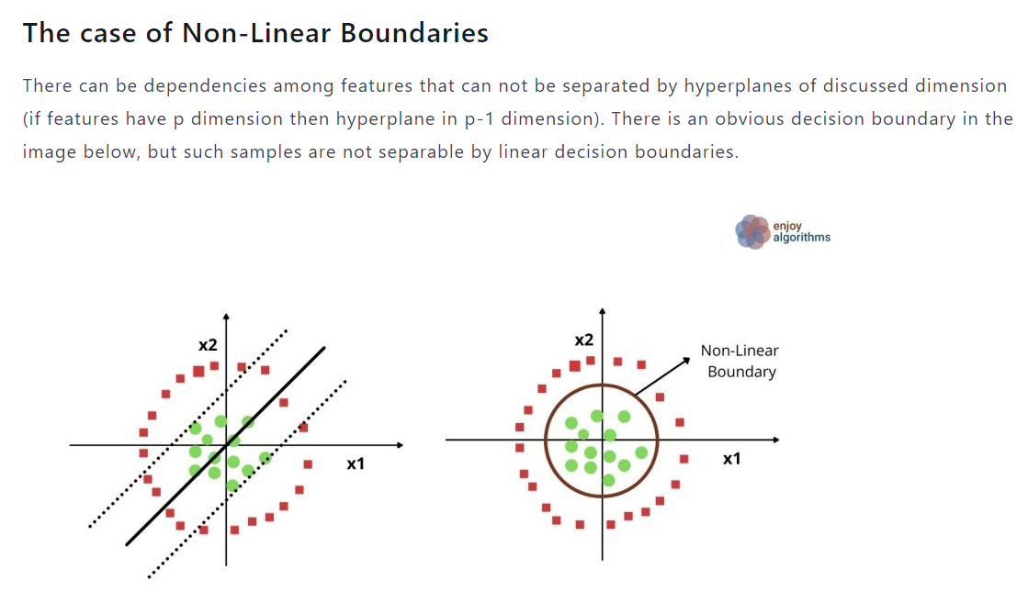
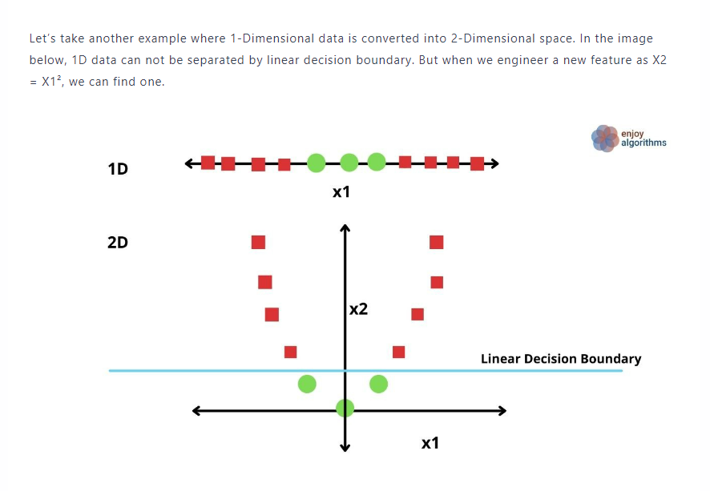
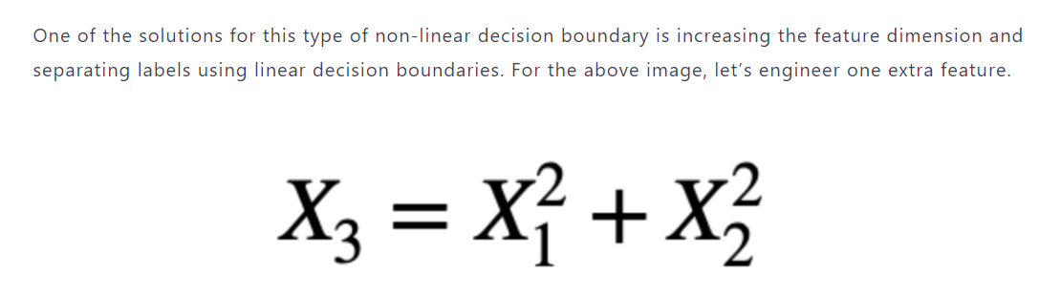

Slide 15
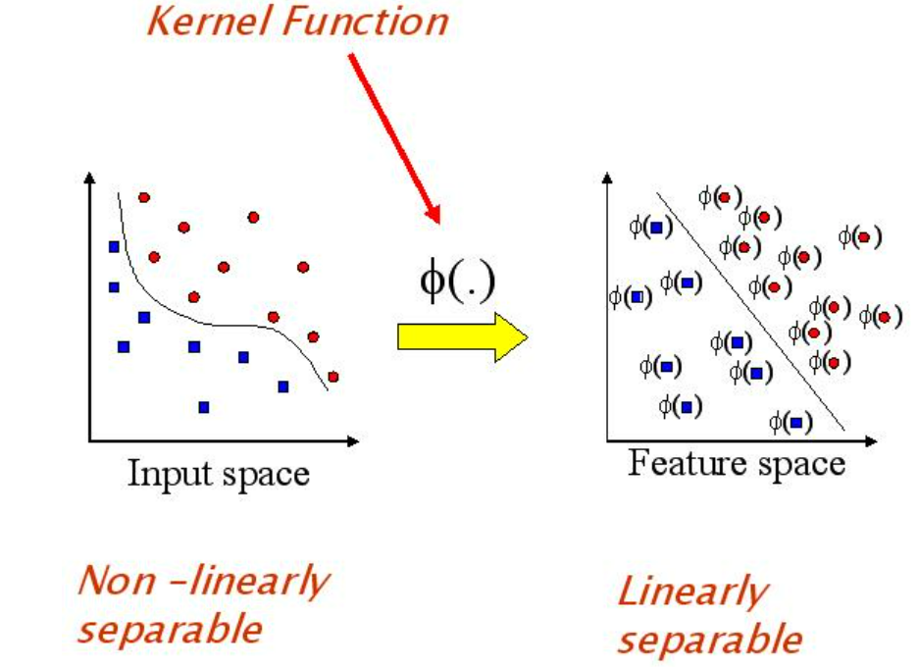
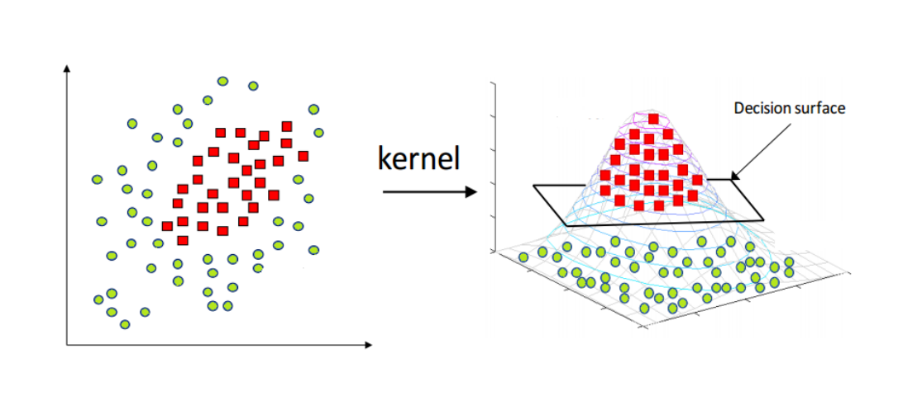
IN CASE OF NON LINEAR BOUNDARIES:
Kernel Trick is widely used in Support Vector Machines (SVM) model to bridge linearity and non-linearity.
It converts non-linear lower dimension space to a higher dimension space thereby we can get a linear classification.
So, we are projecting the data with some extra features so that it can convert to a higher dimension space.
Kernel Trick converts non-linear classification to linear classification by shifting the Lower Dimension Space to Higher Dimensional Space.
Mercer’s theorem helps to convert non-linear data points into Higher dimensions Space.
Steps involved in SVM:-
i) Collects the Data and plot it accordingly
ii) Apply the Kernel Trick
iii) Learns Linear Line that classifies the data
iv) Projects back the data

Slide 16
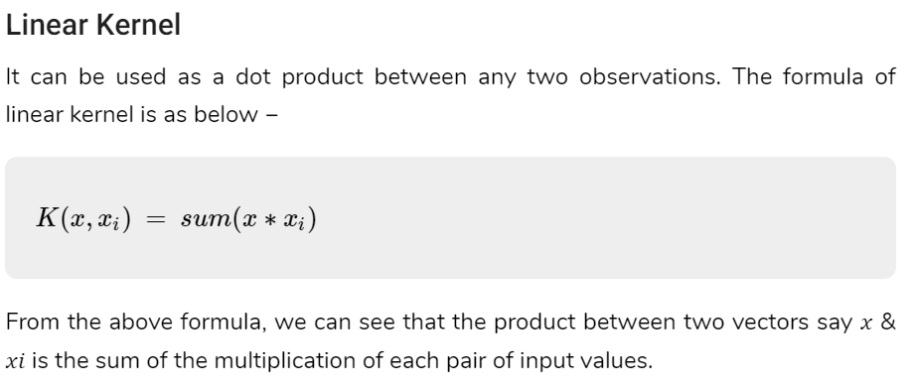
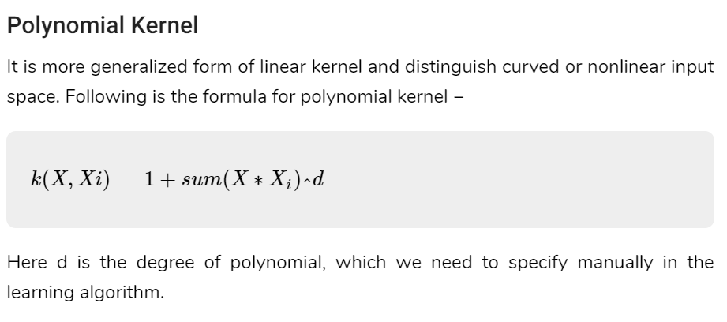
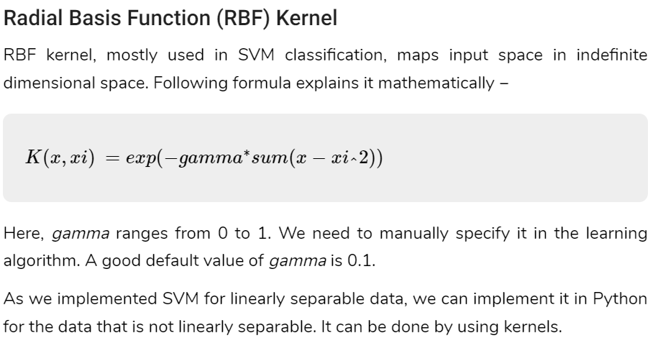
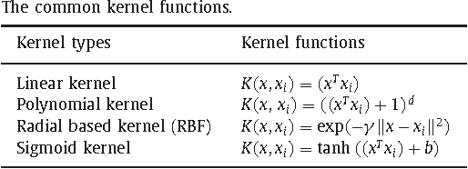

Slide 17
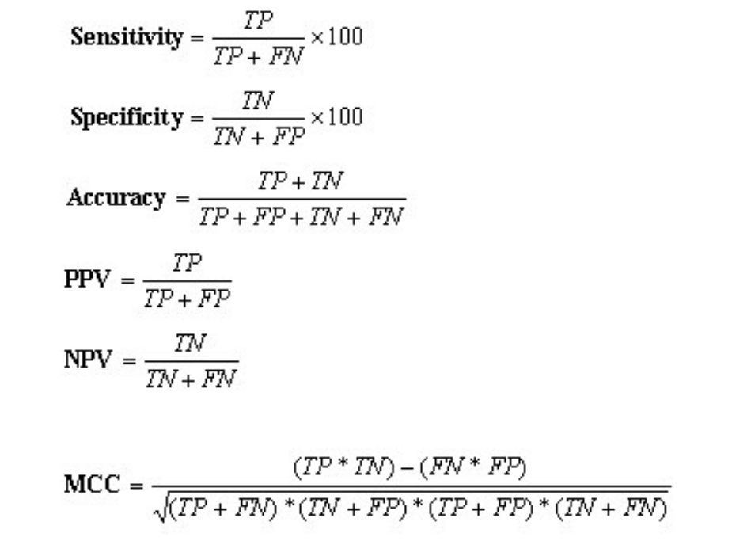
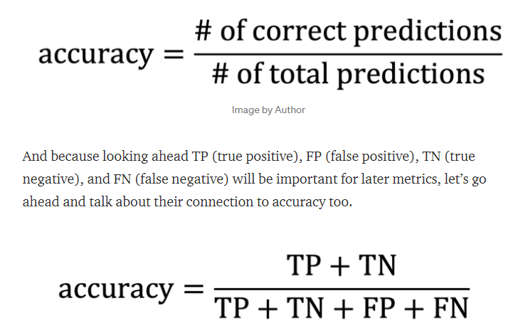
EVALUATION PARAMETERS :
Accuracy :
accuracy is just the percentage of predictions that were made correctly, expressed as a decimal number between 0 (0% of predictions correct) and 1 (100% of predictions correct).

Slide 18
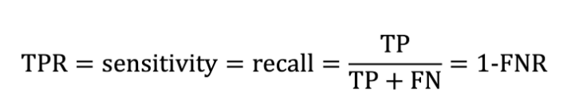
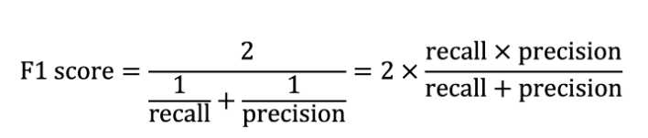
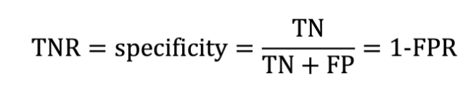
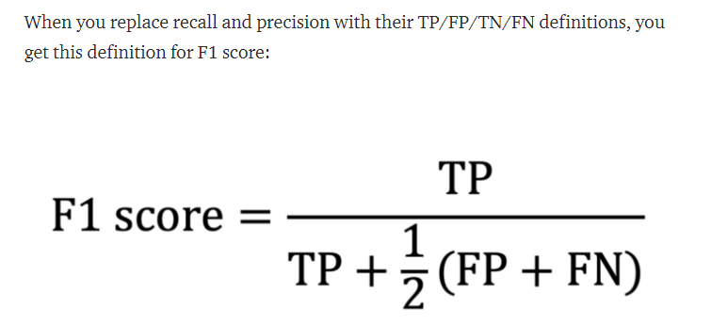
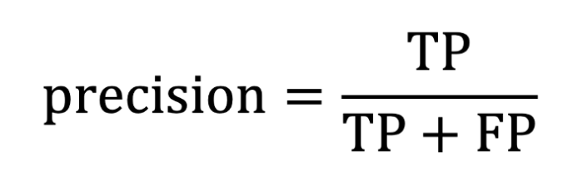
Sensitivity (Recall) and Specificity
F1 Score
F1 score is the harmonic average of recall and precision, taking values between 0 and 1.
Specificity, also called the true negative rate (TNR), is the other side of the coin from sensitivity. It cares about everything sensitivity does, but for the NO cases (the really not-dogs).
Recall and Precision

Slide 19
Support vector machine
import pandas as pd
import numpy as np
from sklearn import datasets
from sklearn import svm, datasets
import matplotlib.pyplot as plt
bc = datasets.load_iris()
X = bc.data
y = bc.target
from sklearn.model_selection import train_test_split
X_train, X_test, y_train, y_test = train_test_split(X, y, test_size=0.30, random_state=1, stratify=y)
from sklearn.preprocessing import StandardScaler
from sklearn.svm import SVC
from sklearn.metrics import confusion_matrix
from sklearn.metrics import precision_score, recall_score, f1_score, accuracy_score
import matplotlib.pyplot as plt
sc = StandardScaler()
sc.fit(X_train)
X_train_std = sc.transform(X_train)
X_test_std = sc.transform(X_test)

Slide 20
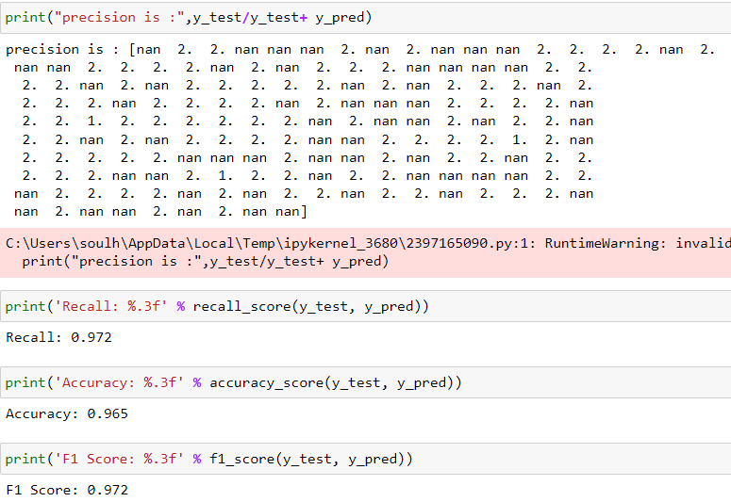
svc = SVC(kernel='linear', C=10.0, random_state=1)
svc.fit(X_train, y_train)
y_pred = svc.predict(X_test)
conf_matrix = confusion_matrix(y_true=y_test, y_pred=y_pred)
fig, ax = plt.subplots(figsize=(5, 5))
ax.matshow(conf_matrix, cmap=plt.cm.Oranges, alpha=0.3)
for i in range(conf_matrix.shape[0]):
for j in range(conf_matrix.shape[1]):
ax.text(x=j, y=i,s=conf_matrix[i, j], va='center', ha='center', size='xx-large’)
plt.xlabel('Predictions', fontsize=18)
plt.ylabel('Actuals', fontsize=18)
plt.title('Confusion Matrix', fontsize=18)
plt.show()
print("precision is :",y_test/y_test+ y_pred)
print('Recall: %.3f' % recall_score(y_test, y_pred))
print('Accuracy: %.3f' % accuracy_score(y_test, y_pred))
print('F1 Score: %.3f' % f1_score(y_test, y_pred))

Slide 21
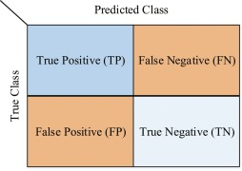
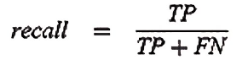
CONFUSION MATRIX

Slide 22
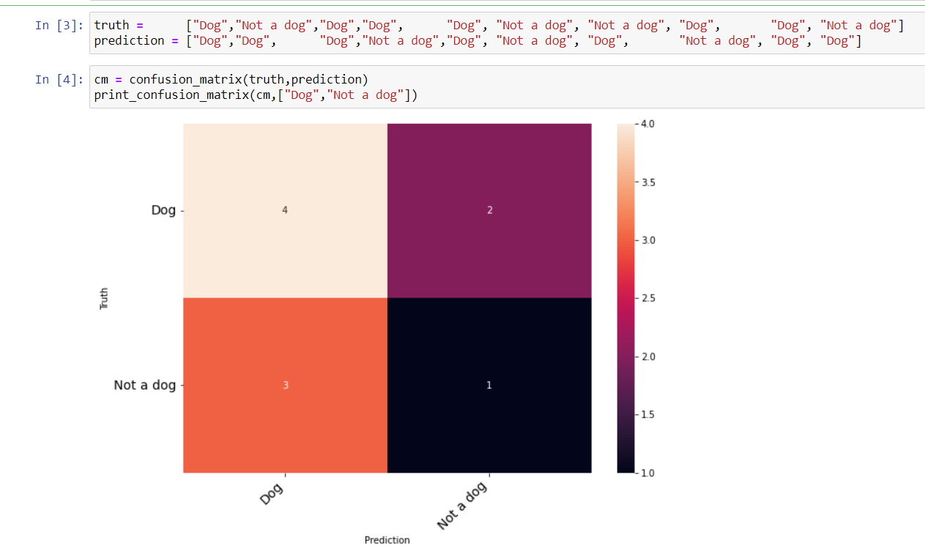
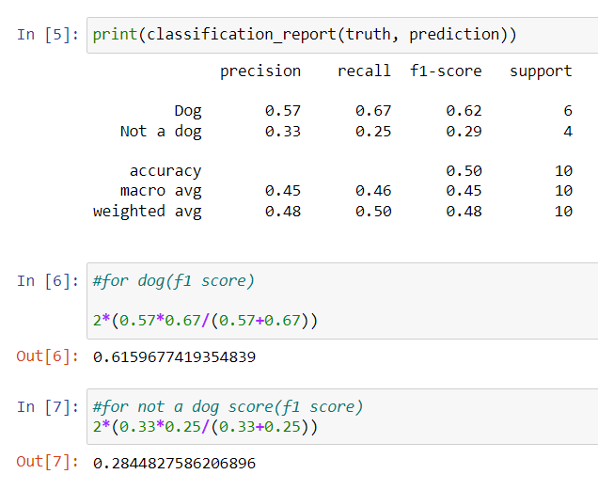
For 10 dog samples and their predictions.

Slide 23
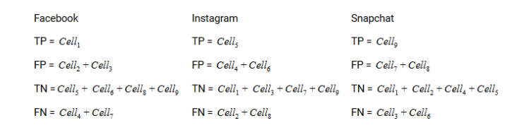
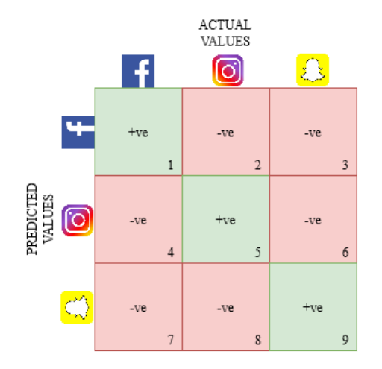
If in case of 3x3 matrix

Slide 24
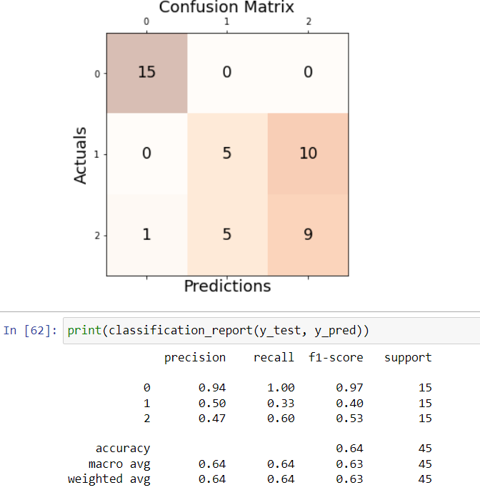
This is iris data - confusion matrix with three classess (Setosa-0, Versicolor-1, Virginica-2)
Below there is a table for precision, recall, f1_score and support.
with the help of classfication_report we can generate this report or manually get the result by providing the values in formula.

Slide 25
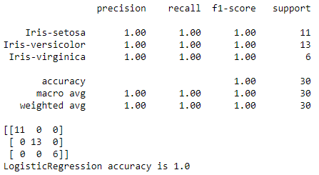
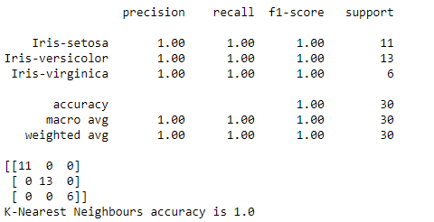
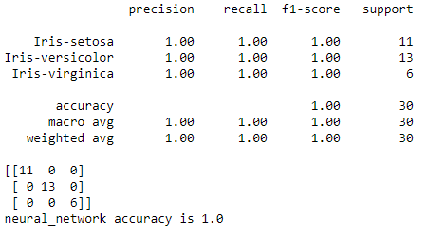


Slide 26





Slide 27




Slide 28


Slide 29


Creating our own Model dataset:
download git and clone with powershell
git clone <link of the Git project>
This downloads the tool of the project to the user directory.

Slide 30

ls
List of the directory
pip install -r requirements.txt
This run the requirements file on the system and this exists in OIDv4_Toolkit.
python main.py
Main.py is a file in OIDv4_Toolkit and should be run under python as file extension.py

Slide 31


python main.py downloader --classes Ballon Airplane Ball_net --type_csv train --limit 400
This executes the main.py file and downloads the required classes

Slide 32

python convert_annotations.py
This executes the convert_annotations file , which means that the file contais the coordinates of the objects or faces.
python main.py downloader --classes <names> --type_csv train --limit 400 --multiclasses
This cmd combines all the coordinates txt files and the jpg folder in one folder for the training
After this manually enter the classes names in the classes.txt file (one by one).

Slide 33
Training our files into weights in colab:-
Requirements:-
Google account
colab
MY Drive
│
│
└───Colab_Notebooks
│
│
└───face_detection_project
│ backup
│ custom_weights ----> Darknet53.conv.74
│ darknet ----> Makefile
│ trainingset ----> Creating-files-data-and-name.py
Creating-train-test-txt-files.py
classes.names.txt

Slide 34



from google.colab import drive drive.mount(“/content/drive”)
!ls ‘/content/drive/My Drive/colab_notebook/face_detection_project’
!unzip ‘/content/drive/My Drive/colab_notebook/face_detection_project/ trainingset.zip’ -d ‘/content/drive/My Drive/colab_notebook /face _detection_project’

Slide 35



!git clone “https://github.com/AlexeyAB/darknet.git” ‘/content/drive /mydrive/colab_notebooks/face_detection_project/darknet’
%cd /content/drive/My drive/colab_notebooks/ face_detection_project /darknet
!make
%cd /content/drive/My drive/colab_notebooks/ face_detection_project

Slide 36

!ls
!python trainingset/creating_files_data_and_name.py
!python trainingset/creating_train_and_test_txt_files.py
!ls
!chmod +x /darknet/darknet
!darknet/darknet

Slide 37

!darknet/darknet detector train trainingset/labelled_data.data darknet/cfg/yolov3_custom.cfg custom_weight/darknet53.conv.74-dont_show

Slide 38

Example Dataset

Slide 39


Slide 40


Slide 41


Slide 42


Slide 43


Slide 44


Slide 45


Slide 46


Slide 47


Slide 48


Slide 49


EXECUTION PART:

Slide 50



Slide 51


Slide 52
THANK YOU

